Slide 1
Shine Jesus Shine

Slide 2
Note: Any videos in this presentation will only play online. After you download the slideshow, you will need to also download the videos from YouTube & add them back into your PowerPoint.
We present these messages at Bee Creek Park in College Station, TX. If you would like to watch the video of the service with this message, click here:
http://campaignkerusso.org/?p=11310
We would love to know more about the people who download our lessons & sermons. We invite you to email us & let us know where & how you use them.
info@ckbrazos.org

Slide 3
Next Slide - Song: Shine Jesus Shine Download Here: http://youtu.be/J3iB30gCqAc

Slide 4
Shine Jesus Shine

Slide 5
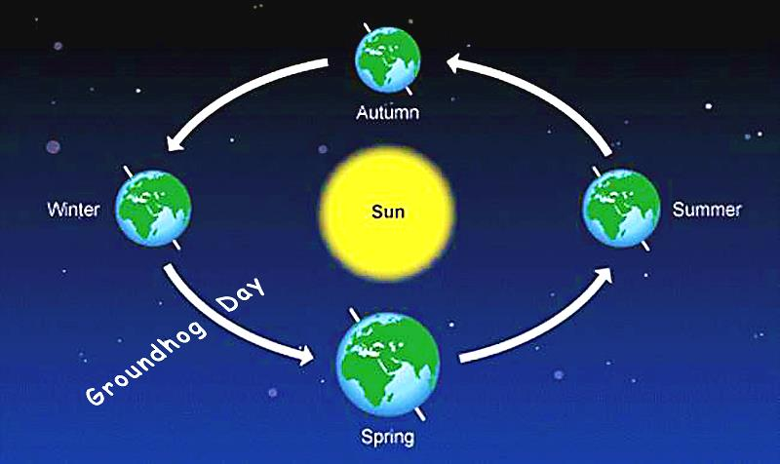
Groundhog Day Explained
February 2nd is the exact halfway point between the Winter Solstice and the Spring Equinox

Slide 6
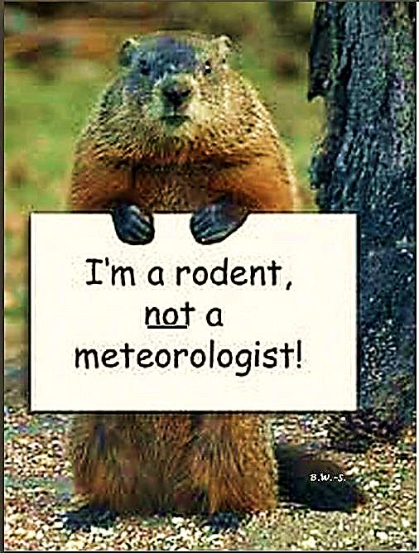
Old Children’s Poem
I see a little groundhog, furry and brown,
He's popping up to look around.
If he sees his shadow, down he'll go.
Six more weeks of winter - oh, no!

Slide 7
In other parts of the world this day is called…
Candlemas or
Feast of the Presentation

Slide 8
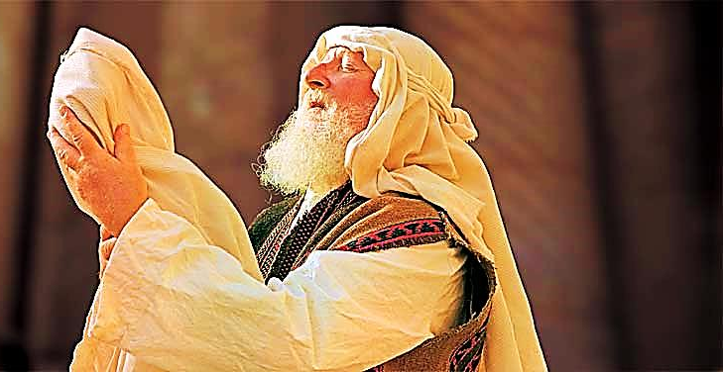
It celebrates the day (40 days after His birth) that Jesus was presented at the Temple
“Then Simeon took Jesus in his arms and praised God… He is a light which will shine for those who do not know God…” Luke 2:29, 32

Slide 9
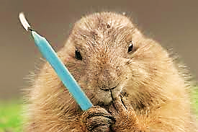
Old children’s poem at Candlemas: "If Candlemas Day be fair and bright, winter will have another flight: If on Candlemas day it be shower and rain, winter is gone and will not come again."

Slide 11
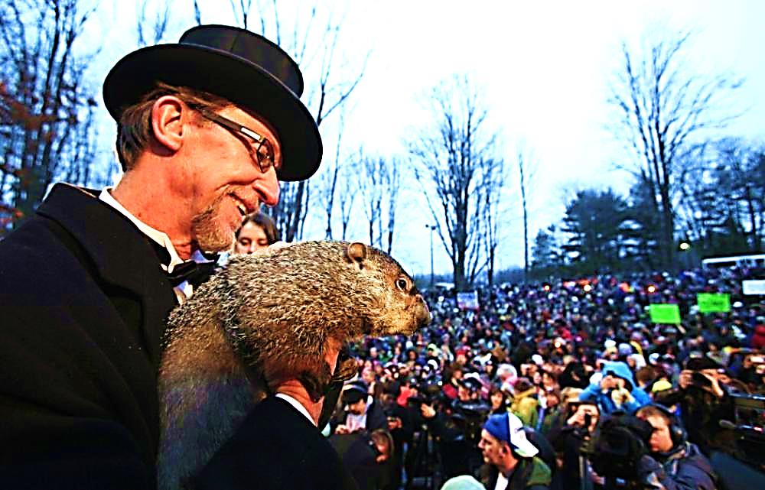
Every year the crowds gather in anticipation of one thing:
Will the groundhog come out and stay out of his hole? Will our winter be over?

Slide 12
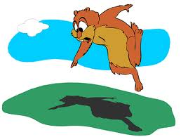
Or will he see his shadow and run back into his hole to hibernate for six more weeks?
Are we
going to
have 6 more
weeks of
winter?

Slide 13
An Old Joke:
One Easter morning, the teacher asked the children about the meaning of Easter.
"Children, today is Easter Sunday. What do we celebrate on Easter?"
One girl spoke up quickly: "We remember our mothers and how much we love them."
"No, that's not quite right," the teacher replied. "You're thinking of Mother's Day.”→

Slide 14
Then, an eager boy took a shot: "Easter is a time when we say 'thank you' to God for all the good things in our lives."
"We can always say 'thank you' to God," the teacher said, "but, you're thinking of Thanksgiving, not Easter.
Children, what is the meaning of Easter?"
After a few seconds of awkward silence, another girl in a fancy Easter dress gave it a try. →

Slide 15
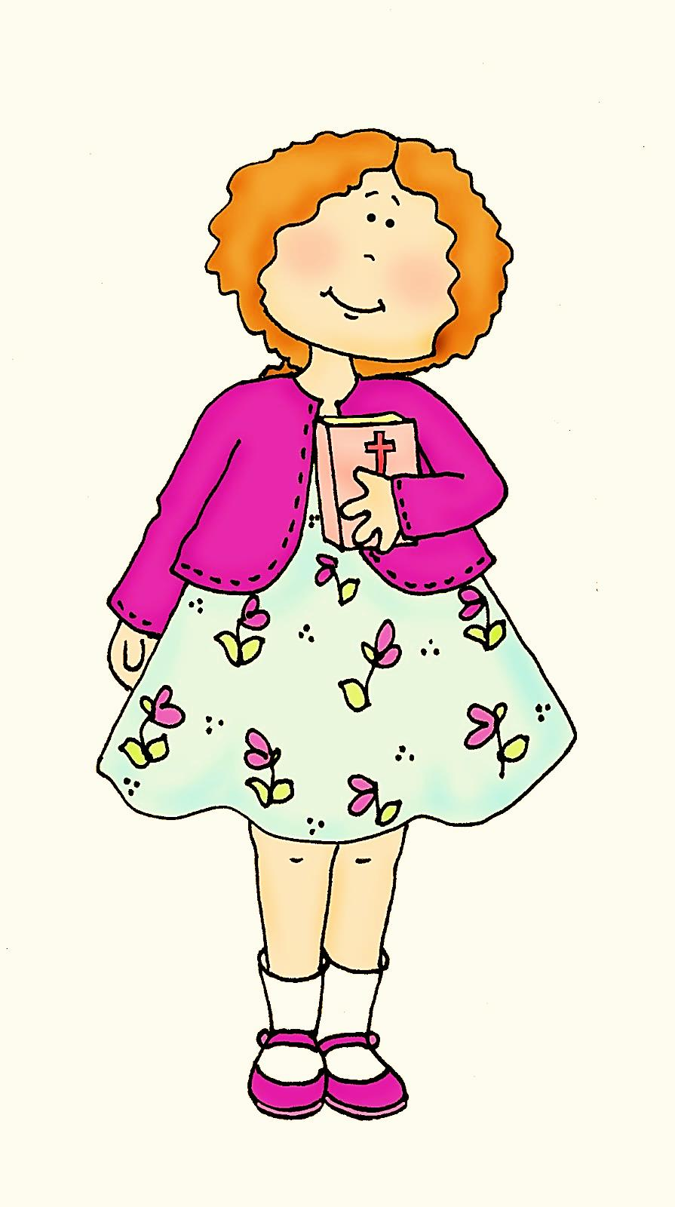
"Easter," she said quietly, "is the day when we remember that Jesus died on the cross for our sins. Then he was buried in the tomb and on Easter morning, God rolled the stone away and Jesus came out of the tomb."
"Excellent," cried the teacher. →

Slide 16
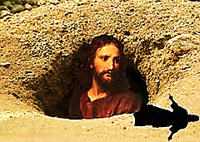
"And then," the girl continued, "Jesus looked and saw his shadow, so he went back into the tomb and there were six more weeks of winter!” (oops!)

Slide 17
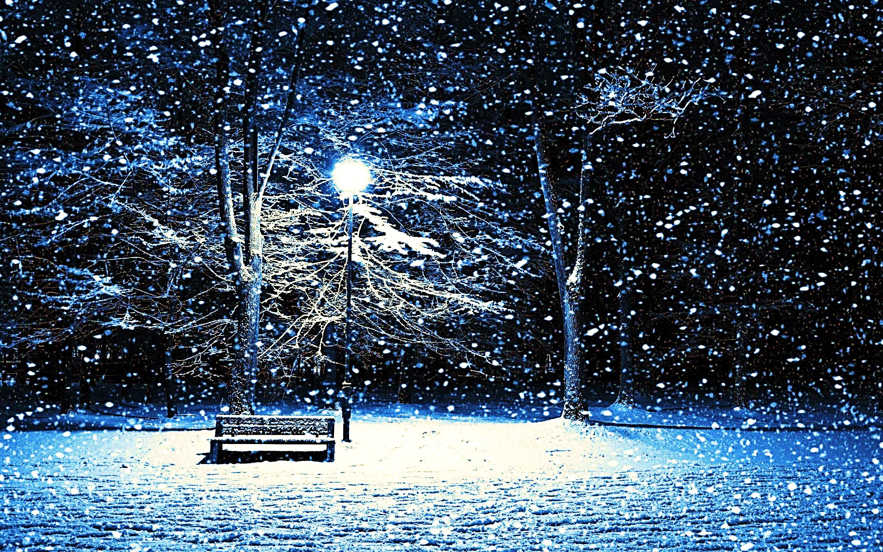
The bible foretold a springtime that was coming to our dark and sinful world.

Slide 18
“Rise up and shine, for your light has come. The shining-greatness of the Lord has risen upon you. For see, darkness will cover the earth. Much darkness will cover the people. But the Lord will rise upon you, and His shining-greatness will be seen upon you.”
Isa. 60:1,2

Slide 19
“The people walking in darkness have seen
a great light. On those living in a pitch-dark land, light has dawned.”
Isa. 9:2
Jesus said:
“I am the light of the world”
John 8:12

Slide 20
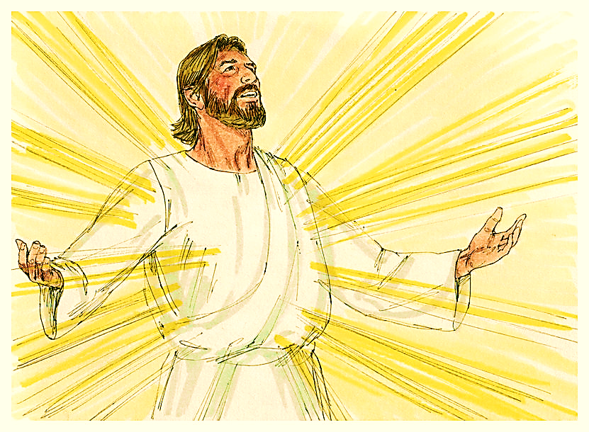
“Jesus was changed in front of them. His face was bright like the sun. His clothes were white, like light.” Matthew 17:2

Slide 21
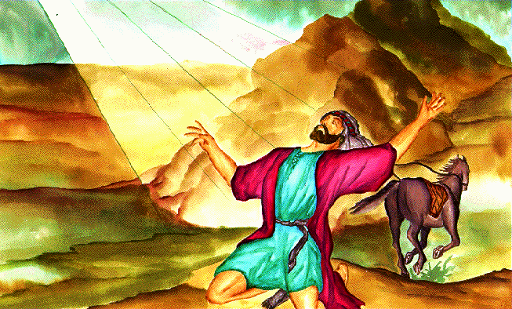
“On the way there, at noon, I saw a light from heaven, brighter than the sun. It shined all around me and those traveling with me.”
Acts 26:13-15

Slide 22
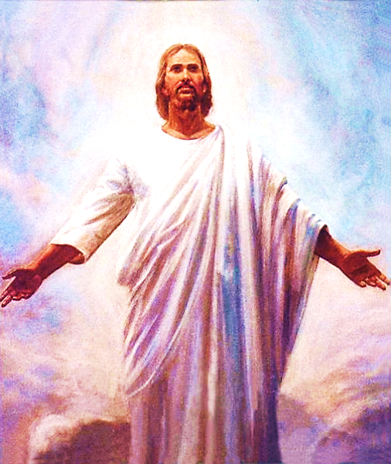
“…His face shone like the sun when it is shining very brightly.”
Rev. 1:16
“…GOD IS LIGHT and no shadow of darkness can exist in him”
1 John 1:5

Slide 23
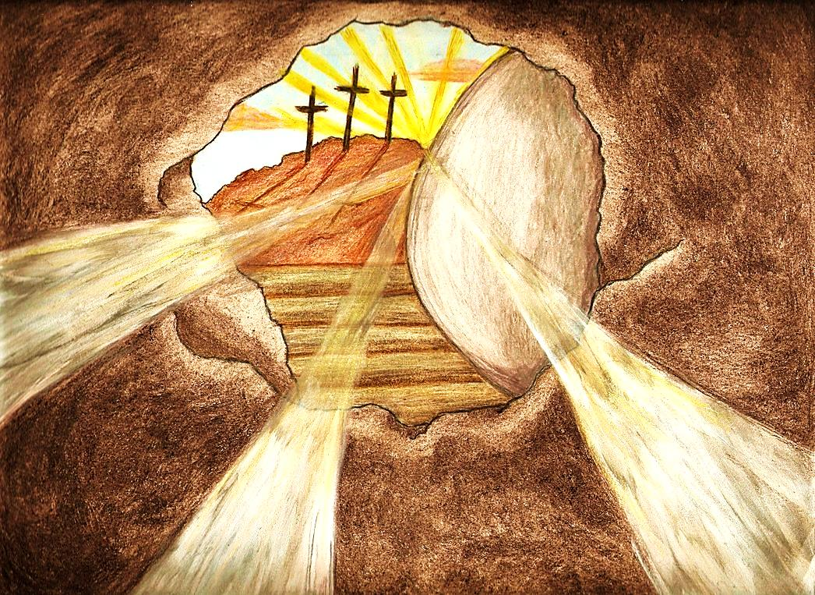
The angels who attended the Resurrection were shining brightly, and likely
(the bible doesn’t say), so was Jesus.
He who is the Light,
can cast no shadow.

Slide 24
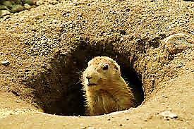
However, we do know this: Jesus didn’t go back into His tomb.

Slide 25
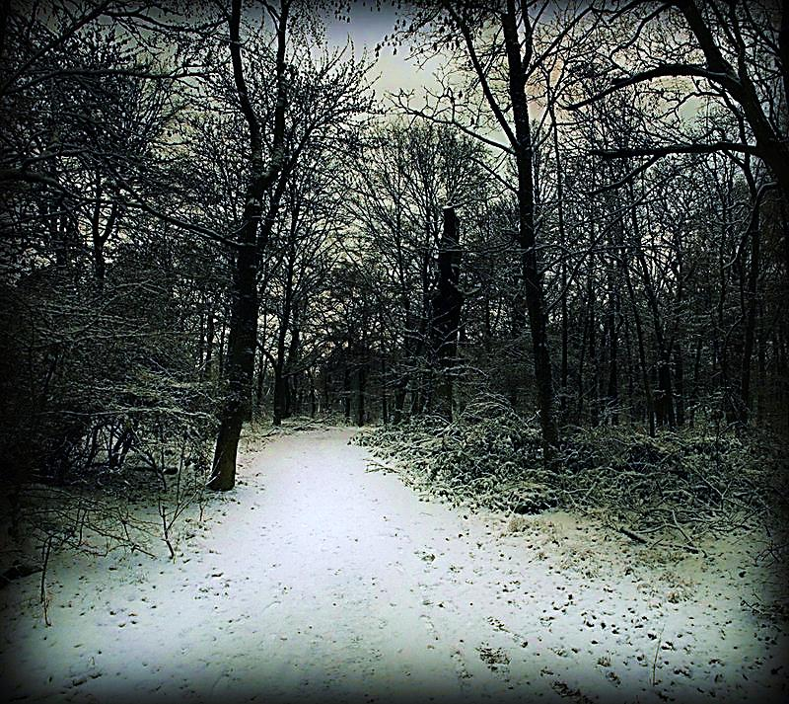
If Jesus went back into the tomb:
We would have no hope, we would be stuck in darkness forever.

Slide 26
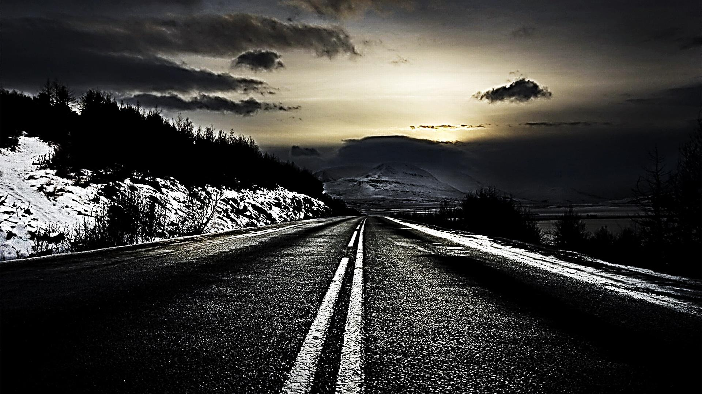
If He had gone back, our Spiritual Winter would never end.

Slide 27
But, if Jesus did stay out, winter would be over and new life would emerge!
On Resurrection Day, watchers might have asked, “Will Jesus come out and stay out to bring the light of spring to a sin dark world?”

Slide 28
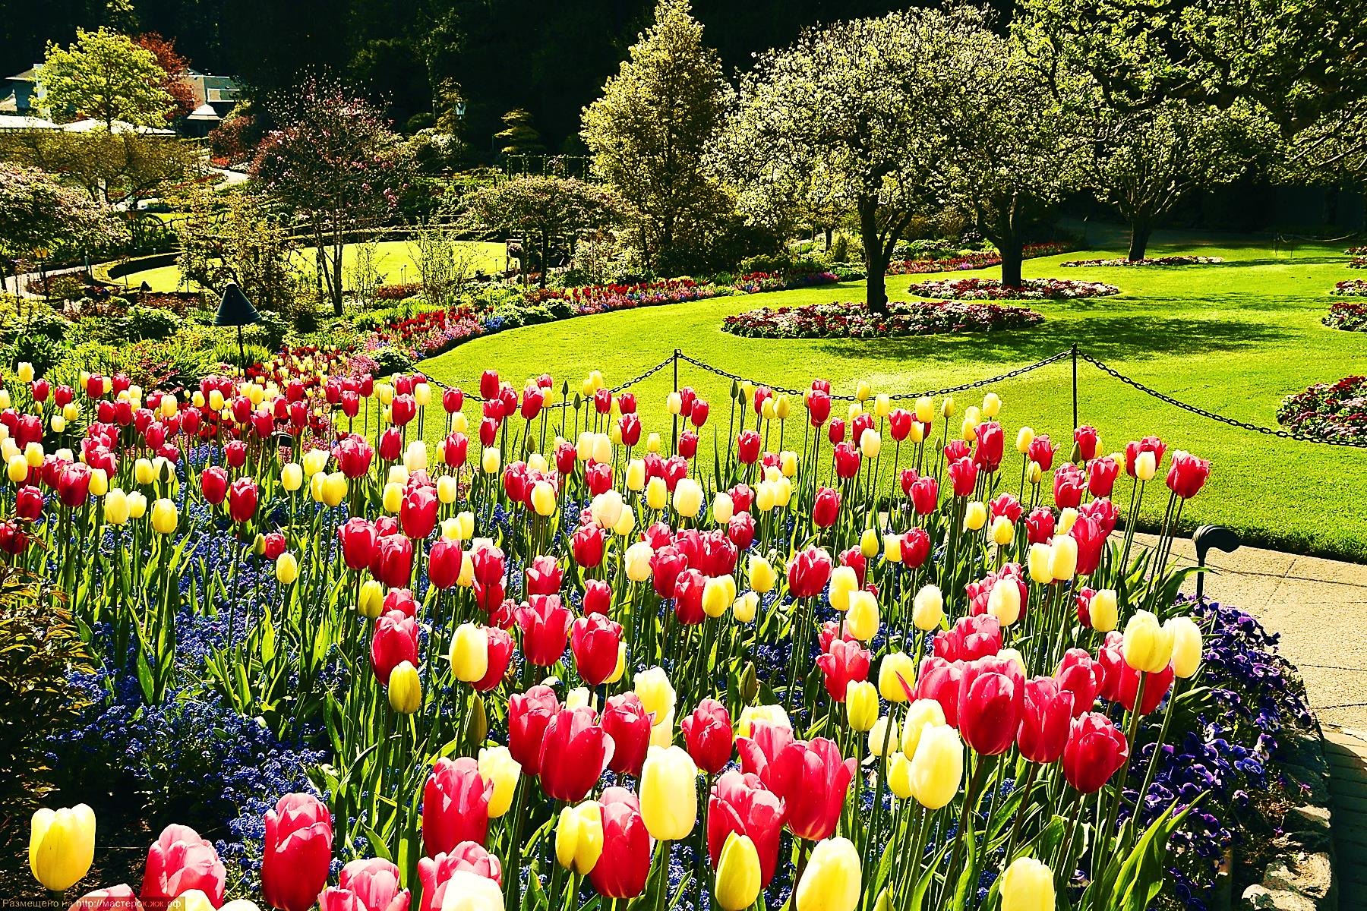
“For see, the winter is past. The rain is over and gone. The flowers are coming through the ground. The time for singing has come.”
Song 2:11-12

Slide 29
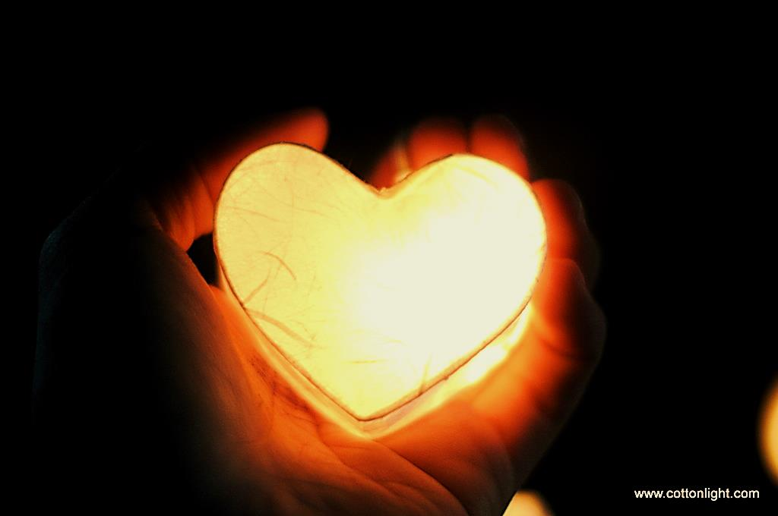
“It was God Who said, “The light will shine in darkness.” He is the One Who made His light shine in our hearts…”
2 Cor. 4:6

Slide 30
The groundhog may go back, but Jesus brings new life—the winter of our soul can be over.

Slide 31
“O God, bring us back to You. Make Your face shine upon us, that we may be saved.” Psalm 80:3

Slide 32
Next Slide - Song: Shine Jesus Shine Download Here: http://youtu.be/J3iB30gCqAc

Slide 33
Is Jesus Speaking to You?
“They said to each other, ‘Did not our hearts burn within us while he talked to us on the road, while he opened to us the Scriptures?’”
John Wesley Said:
“…the preacher was describing the change which God works in the heart through faith in Christ and I felt my heart strangely warmed.”
Jesus makes His presence Known by a small voice!

Slide 35
What is the Sinner‘s Prayer?
This is a prayer we can pray when we are ready to admit we are sinners and need Christ’s forgiveness.
It must be prayed with faith in our hearts and a readiness to have a life-changing encounter with Jesus Christ.

Slide 36
A prayer of faith → Pray this prayer if :
If you never have before
You have in the past, but you think it would mean more today
You have been walking afar off and you want to come back
You want to set an example & show others how it is done
You just like to give your heart to Jesus again & again
Faith

Slide 37
We Declare Our Faith Publicly Because Jesus Declared His LOVE Publicly
“If you stand before others and are willing to say you believe in me, then I will tell my Father in heaven that you belong to me.” Mat 10:32

Slide 38
Important Questions
Do you want to know Jesus as your Savior right now?
Do you believe He died to save you from your sins & that He rose from the dead?
Do you believe that He is here, waiting to save you right now?

Slide 39
The Prayer of a Sinner Turning to Jesus
Dear Jesus, I know that I have sinned against You and that my sins separate me from You.
I am truly sorry.
Right now, I turn away from my sinful past .
Please forgive me, and help me to keep from sin.
I believe You died for my sins.
I Believe You rose from the dead, you are alive, and you hear this prayer from my heart.
I invite You Jesus to be both my Savior and the Lord of my life.
I want You to rule my life from now on.

Slide 40
“But some people did accept him. They believed in him, and he gave them the right to become children of God.”
John 1:12

Slide 42
“If you openly say, ‘Jesus is Lord’ and believe in your heart that God raised him from death, you will be saved.”
Rom. 10:9
What did you learn today?
What is the meaning of the name-tag?
What have you been thinking about God lately?
What do you want to tell the world about Jesus?

Slide 43
“Draw near to God, and He will draw near to you…
Altar Time
…Cleanse your hands, you sinners, and make your hearts pure, you who are half-hearted towards God.” James 4:8 WNT

Slide 44
Close in Prayer

Slide 45
Note: Any videos in this presentation will only play online. After you download the slideshow, you will need to also download the videos from YouTube & add them back into your PowerPoint.
We present these messages at Bee Creek Park in College Station, TX. If you would like to watch the video of the service with this message, click here:
http://campaignkerusso.org/?p=11310
We would love to know more about the people who download our lessons & sermons. We invite you to email us & let us know where & how you use them.
info@ckbrazos.org

Slide 46
Welcome to Aggieland Faith Family Style Worship

Slide 47
CURRENT SCHEDULE: See www.Aggielandfaith.org
Three Sunday Services
First Sunday Service:
Basics – 15-20 min.
Includes – Snacks, Crafts, Prizes & Bible
We are going through the New Testament
Second Sunday Service:
Middle Level – 20-30 min.
Includes – Snacks, Prizes & Bible
We are going through the Old Testament
Third Sunday Service:
Advanced – 30-40 min.
Includes – Snacks, Prizes & Bible
We are studying the Tabernacle

Slide 48
Would You Like Prayer or Bible Study at Your House?
Personal Prayer: We can come to your home & pray with you, or you can email us when you need prayer.
Home Bible Study: We will come to your home & hold a bible study for you & your friends.
Bible Party: We will hold a Kid’s Bible Party: You provide the food & kids - we will do the bible fun & stories.

Slide 49
Would You Like Visitation?
We will visit a friend, loved one in the hospital or in prison to pray for them & share Christ with them.
Contact: info@aggielandfaith.org

Slide 50
www.aggielandfaith.org
Go here to see pictures & videos
Go here to subscribe to e-mails about changes & cancellations

Slide 51
Note: Any videos in this presentation will only play online. After you download the slideshow, you will need to also download the videos from YouTube & add them back into your PowerPoint.
We present these messages at Bee Creek Park in College Station, TX. If you would like to watch the video of the service with this message, click here:
http://campaignkerusso.org/?p=11310
We would love to know more about the people who download our lessons & sermons. We invite you to email us & let us know where & how you use them.
info@ckbrazos.org

